Slide 1
EYE PATTERN
ECE 416 – DIGITAL COMMUNICATION
Wednesday, 22 November 2023

Slide 2
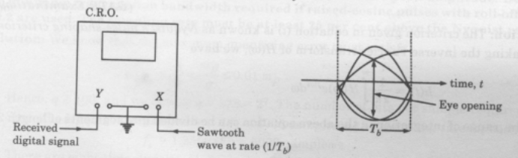
EYE PATTERN-DEFINITION
In telecommunication, an eye pattern, also known as an eye diagram, is an oscilloscope display in which a digital data signal from a receiver is repetitively sampled and applied to the vertical input, while the data rate is used to trigger the horizontal sweep.
The eye pattern is used to study intersymbol interference and its effect on data communication systems.

Slide 3
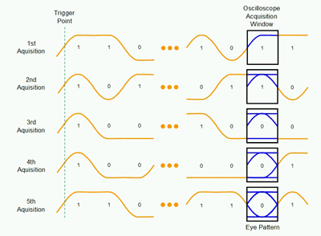
FORMATION OF THE EYE PATTERN
A triggered eye pattern is formed over multiple acquisitions.
Five consecutive acquisitions using the triggered method are shown above.
In each case, the trigger point is an arbitrary rising edge.
The scope is triggered sufficiently early (far left off-screen) to ensure that the only data collected is for randomized transitions within the acquisition window.

Slide 4
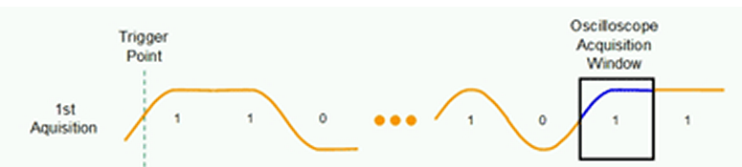
CLOSER LOOK AT 1ST ACQUISITION
A unit interval is collected in which the data is transitioning from a logic zero to logic one in the left half of the acquisition window, and from a logic one to a logic one in the right half of the acquisition window (shown in blue).
The eye pattern, after one acquisition, includes only the area shown in blue.
The transitions occurring outside the acquisition window (shown in orange) are not acquired and are not used in the eye pattern formation.

Slide 5
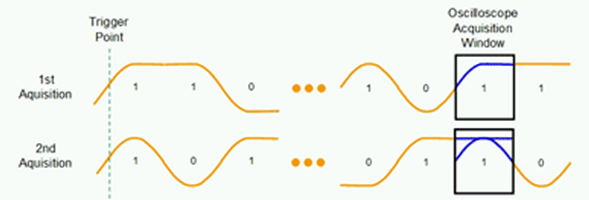
CLOSER LOOK AT 2ND ACQUISITION
The 2nd acquisition also triggers on a rising edge far off-screen to the left (earlier in time than the acquisition window).
Within the acquisition window, a unit interval is collected that begins at logic one at the left edge of the display and transitions to a logic zero level at the right edge of the display.
Because a persistent display is used when forming an eye pattern, the 0 1 1 transition pattern of the first acquisition is combined with the 1 1 0 pattern of the second acquisition, forming the persistent display shown in blue.

Slide 6
3RD ACQUISITION
For the third acquisition, a 0 0 0 pattern occurs, forming the straight blue line along the bottom of the eye pattern display

Slide 7
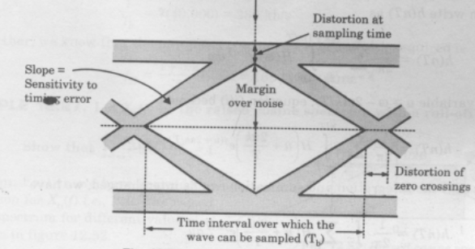
CONTINUOUS-BIT EYE PATTERN RENDERING
Continuous-bit eye pattern rendering was first implemented in 2002
It is currently available today from all vendors of high-performance real-time oscilloscopes.

Slide 8
INFORMATION OBTAINED FROM THE EYE PATTERN
Several system performance measures can be derived by analyzing the display.
If the signals are:
    (a) too long,
    (b) too short,
    (c) poorly synchronized with the system clock,
    (d) too high, too low, too noisy, or too slow to change, or
    (e) have too much undershoot or overshoot,
All the above can be observed from the eye diagram.

Slide 9
ERROR DETECTION
ELC 451
Friday, 05 February 2016

Slide 10
ERROR DETECTION AND CORRECTION
Error detection and correction or error control are techniques that enable reliable delivery of digital data over unreliable communication channels.
The most Common Error Detection Methods are:
    (a) Parity Checking
    (b) Checksum error detection
    (c) Cyclic Error Check (CRC)

Slide 11
PARITY CHECKING
Parity checking methods introduce an additional bit, called a parity bit which is added to each data word.
A parity bit, or check bit, is a bit that is added to ensure that the number of bits with the value one in a set of bits is even or odd.
Parity bits are used as the simplest form of error detecting code.
The additional bit is chosen so as to make the resulting word have even or odd parity.
    (a) Even parity is when the number of ‘1’ bits in the word is even
    (b) Odd parity is when the number of ‘1’ bits is odd.

Slide 12
EVEN PARITY
The number of ‘1’ bits in the data word is 4, i.e Even, therefore Parity bit is 0.
01001011
The number of ‘1’ bits in the data word is 3, i.e Odd, therefore Parity bit is 1.
10010011
PARITY BIT | DATA WORD
0 | 1001011
PARITY BIT | DATA WORD
1 | 0010011

Slide 13
ODD PARITY
The number of ‘1’ bits in the data word is 4, i.e Even, therefore Parity bit is 1.
11001011
The number of ‘1’ bits in the data word is 3, i.e Odd, therefore Parity bit is 0.
01000110
PARITY BIT | DATA WORD
1 | 1001011
PARITY BIT | DATA WORD
0 | 1000110

Slide 14
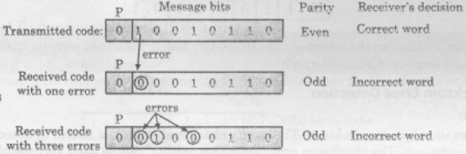
ERROR DETECTION
Parity check at the receiver detects an error if the parity of the received word is different from the expected parity.

Slide 15
FAILURE OF PARITY CHECKING METHOD
If the number of errors introduced in a transmitted word is two or any even number, then the parity does not change and the receiver will fail to detect the presence of errors.
If the number of errors introduced in a transmitted word is one or any odd number, then the parity changes and the receiver can detect the presence of errors but cannot correct.

